Slide 1
Kmart Fashion and Style SIP Plan
 | PHASE 1 | PHASE 2
Goal | Update for Spring 2012 Lookbook | Streamline flow, reduce manual updates, make product content dynamic
Pain Points Addressed | Outdated Lookbook Lookbook not shoppable | Manual video update every 2 weeks Manual update of Lookbook pages every quarter Manual image content and shoppable product list update every month Pricing info not the same when clicking to product page; No indication if item in a look is out of stock Inconsistent Brand Shop flows
High Level Features | Minor UI improvements Lookbook Content Update Make Lookbook Shoppable Remove Brand links and drop down | Add back Brand links and Drop Downs Brand links to Search Results page with Brand KSR Dynamic Video Content from YouTube Dynamic Lookbook Pages leveraging WordPress
- COMPLETED

Slide 2
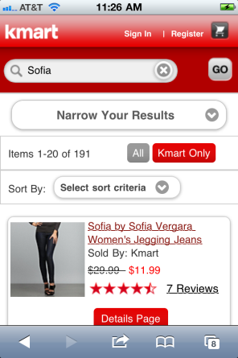
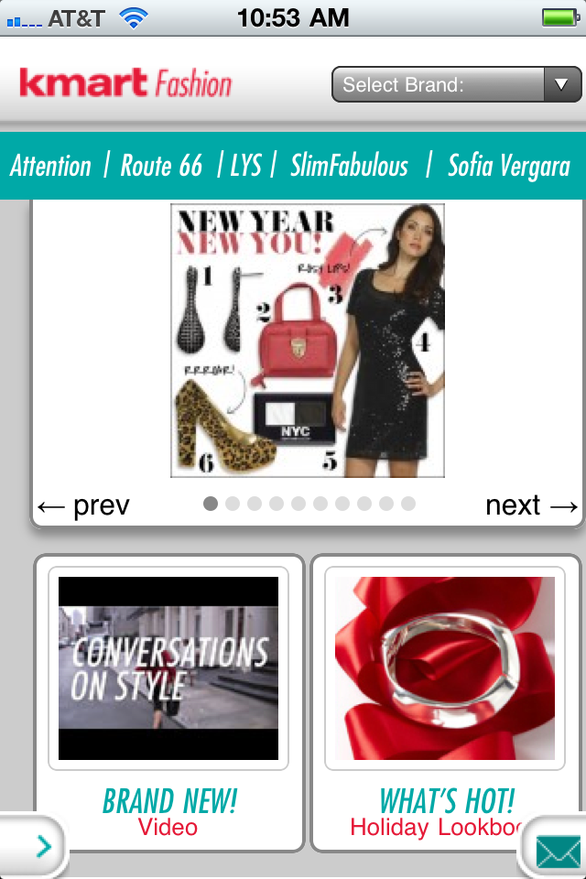
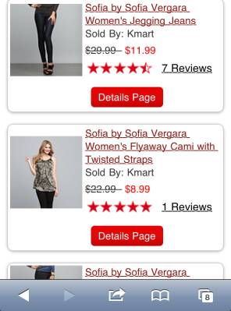
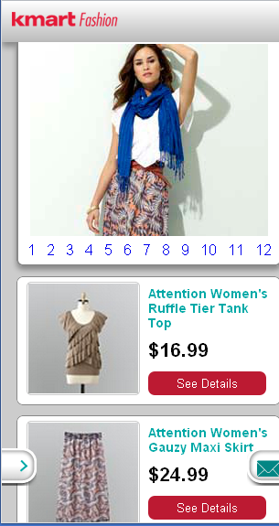
Phase 2 (Kmart Fashion and Style SIP)
KEY BENEFITS:
No need to update videos manually every 2 weeks.
No need to update brand shop page content (up to 4 product items x 4 looks x 8 brands across 2 sites).
No need to manually update lookbook pages every quarter.
Pricing and inventory info is always consistent .com
Tapping each brand will take user to Kmart Mobile Web Search Results page listing all products that are part of that brand
Feed from YouTube playlist. Goes to Youtube preview page that displays video thumbnails for all videos in the playlist
*IMPORTANT NOTE:
Screenshots are indicative – for illustration purposes. Not final screenshots
Leverage .com/Wordpress solution to feed data that will display on Lookbook pages. Will display up to 12 Looks, will display current pricing and out of stock info

Slide 3
Costs
 | Phase 1 | Phase 2
Costs | ?? | ??
Date | 2/8** | TBD***
STATUS | COMPLETED | PENDING APPROVAL
** Contingent on delivery of Signed SOW and Final Product/PID list for Shoppable Product List by xx
*** To be determined after confirmation/ approval of Phase 2 work.

